Slide 1


NFL
Scorecard Overview February 2026

Slide 2




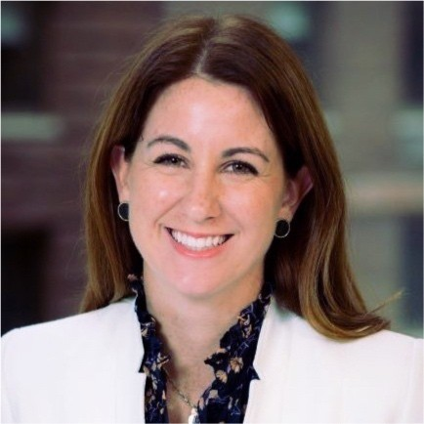
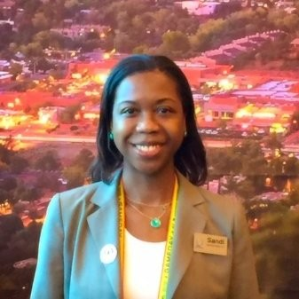

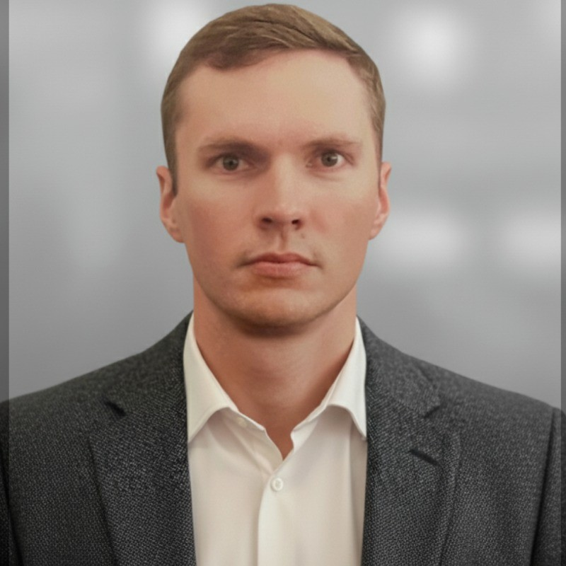
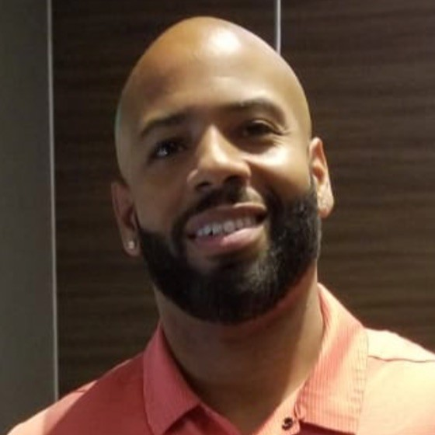

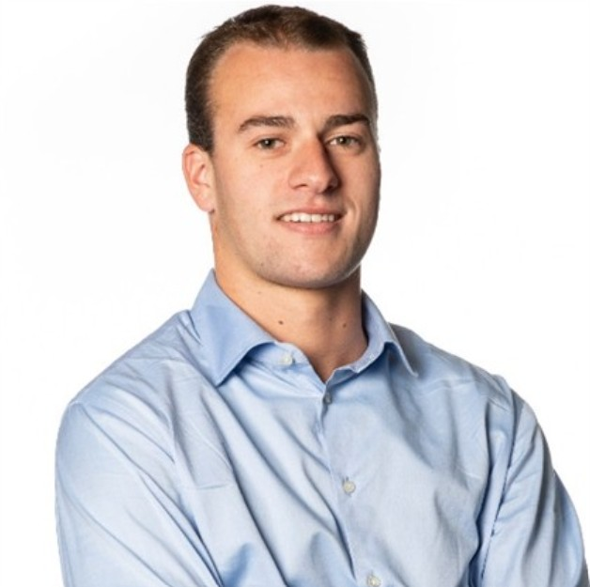
Introducing the Team
Aaron Amendolia
Jefferson Wang
Elizabeth Keating
Deputy CIO
Cloud First Chief Strategy Officer
Client Account Lead
Sandra Manigault
Vik Arya
John Shearin
VP, IT Strategy & Business Ops
Delivery Lead
Project Exec & SMA
John Noble
Kieran McConnell
Robert Treiber III
Director, Club & Stadium IT
Business Value Lead
Survey Design Lead

Slide 3
Stadium Technology Scorecard | Phase 2 Project Scope & Opportunity Areas
PROJECT OVERVIEW
OPPORTUNITY AREAS THROUGH BENCHMARKING
Accenture will assist the NFL in designing, building, and launching a Stadium Technology Scorecard Dashboard — a Tableau-based visualization that CAN scores and rank all 32 NFL clubs and 3 international teams across fan experience and venue technology dimensions. The dashboard will surface performance gaps and support data-driven investment decisions across stadium operations and technology infrastructure.
01
Fan Journey Experience
Ticketing, gate entry, wayfinding, concessions, merchandise & in-game social touchpoints
02
Connectivity & Infrastructure
Network, Wi-Fi, DAS, ISP circuits, edge/cloud, and digital services backbone
IN-SCOPE ACTIVITIES
Framework refinement — align existing data to fan experience journey points and key technology enablers
Survey design & validation — develop survey catalog and validate with 3 NFL clubs via working sessions
Dashboard build & test — develop backend logic, Tableau visualization, and functional testing for all 35 teams
Voice of the Fan integration — incorporate 2 survey questions to correlate fan sentiment with infrastructure data
Production release — finalize survey & dashboard; provide NFL access to share with all clubs
User guides — survey and dashboard guides for end-user consumption
03
Stadium Operations
Safety & security, crowd control, food & beverage, VIP suite analytics, ticket acceptatnce
04
Data & AI Enablement
Application intelligence, data capture maturirt, scoring logic & AI-driven logistics
05
Transaction & Commerce
Cashless payments, merchandise tech, concession throughput & revenue optimization
06
Immersive & Future Tech
Innovation gaps, next-gen fan engagement, global stadium benchmarking trends
START
FRAMEWORK
SURVEY
DASHBOARD
GO-LIVE
March 25, 2026
WK - #-#
WK - #-#
WK - #-#
MAY 6, 2025

Slide 4

Status | {Day}, {Month} {Day}, 2026 {Month} – {Date} to {Date}
Scope/Objective | Owners
{scope objective statement} | Kieran McConnell Robert Treiber III Vikram Arya
{short listing of near-term objectives}
{short listing of near-term objectives}
{short listing of near-term objectives}
{short listing of near-term objectives}
{short listing of near-term objectives}
Accomplishments | Completed
{single sentence accomplishment since last week} | {month}/{day}
{single sentence accomplishment since last week} | {month}/{day}
{single sentence accomplishment since last week} | {month}/{day}
Near-Term Objectives
Project Health
Risk / Issue | Status
{single sentence risk or issue statement}
{single sentence risk or issue statement}
{single sentence risk or issue statement}
{single sentence risk or issue statement}
Upcoming Milestone | Date
{brief listing of nearest milestone} | {month}/{day}
{brief listing of next nearest milestone} | {month}/{day}
{brief listing of next nearest milestone} | {month}/{day}
{brief listing of next nearest milestone} | {month}/{day}
Next Steps & Notes
Major issues
Minor risk
On track
Not started
{single sentence of next step / upcoming activity}
-
-
-

Slide 5
Phase 2 Assessment Timeline
Last Updated | {Month, Day, Year}
KEY ACTIVITIES
W1
W2
W3
W4
W5
W6
A: Del. A: Stadium Technology Framework (PPT)
B: Del. B: Club Technology Survey (Google Survey)
C: Del. C: Visualization Dashboard (Tableau)
D: Del. D: Guides (PDF)
Framework
Development
Project Kickoff
› Stakeholder alignment meetings
› Finalize vision & guiding principles
› Schedule workshops & reviews
Framework Development
A
› Finalize assessment criteria & scorecard
› Ingest Voice of Fan (2 questions)
› Finalize & test methodology + scoring logic
› Refinement based on validations
Framework
Validations
Team Validations (3 clubs)
B
› Workshops with 3 clubs
› Gather framework & survey feedback
› Update survey based on insights
Dashboard
Development
Survey Tooling & Dashboard Dev
› Finalize survey on updated framework
› Tableau visualization based on methodology
› Connect survey data to dashboard
Data Transformation
› Develop survey system logic
› Develop data cleanse logic
› Dashboard creation
Testing & Refinements
› Solution testing
› Visualization refinements based on feedback
Survey &
Dashboard
Finalization
Survey Release
C
› Send out surveys to all clubs
› Communication to all 35 teams
Dashboard Release
D
› Dashboard go-live
› Post-release monitoring

Slide 6
WIP
Milestone
Phase 2 Assessment Timeline Last Updated | {Month, Day, Year}
 | Key Activities | W1 | W2 | W3 | W4 | W5 | W6 | W7 | W8
Framework Development | Project Kickoff: Stakeholder alignment meetings Finalize vision and guiding principles Scheduling workshops and reviews
 | Framework Development: Finalize detailed assessment criteria and scorecard. Ingest Voice of Fan survey Finalize & Test methodology and scoring logic Refinement based on validations
Framework Validations | Team validations (3 clubs) Workshops with 3 clubs to refine survey
Dashboard Development | Survey Tooling & Dashboard Development Finalize survey on updated framework Tableau visualization based on methodology
 | Data Transformation Develop survey system logic Develop data cleanse logic Source data preparation Dashboard creation
 | Testing & Refinements Solution testing Visualizations refinements based on feedback
Survey & Dashboard Finalization | Survey Release Send out surveys
 | Dashboard Release Dashboard go-live post survey results
A
B
C
D

Slide 7

Enabling The Digital Fan & Operations Experience
Exploring experience and technology to create a frictionless physical + digital journey
Fan Experience
Physical and digital interactions experienced by fans / visitors throughout their journey
DIFFERENTIATED
EXPERIENCE AND CAPABILITIES
Operations
Capabilities that facilitate venue and team staff to optimize operations and support the fan, team and event experience
AI & Innovation Services
Agentic AI and next generation Innovation enabling the Fan Experience and Team Operations
TECHNOLOGY VISION AND
PLATFORM
Cloud and Edge Platform
Remote and scaled management of devices and experiences plus Edge compute
PHYSICAL + DIGITAL
ENABLEMENT
AND EXECUTION
Network and Connectivity
Wired/wireless communications connecting platforms, devices, and users
Physical Infrastructure and Devices
Devices and sensors collecting interaction and source data

Slide 8
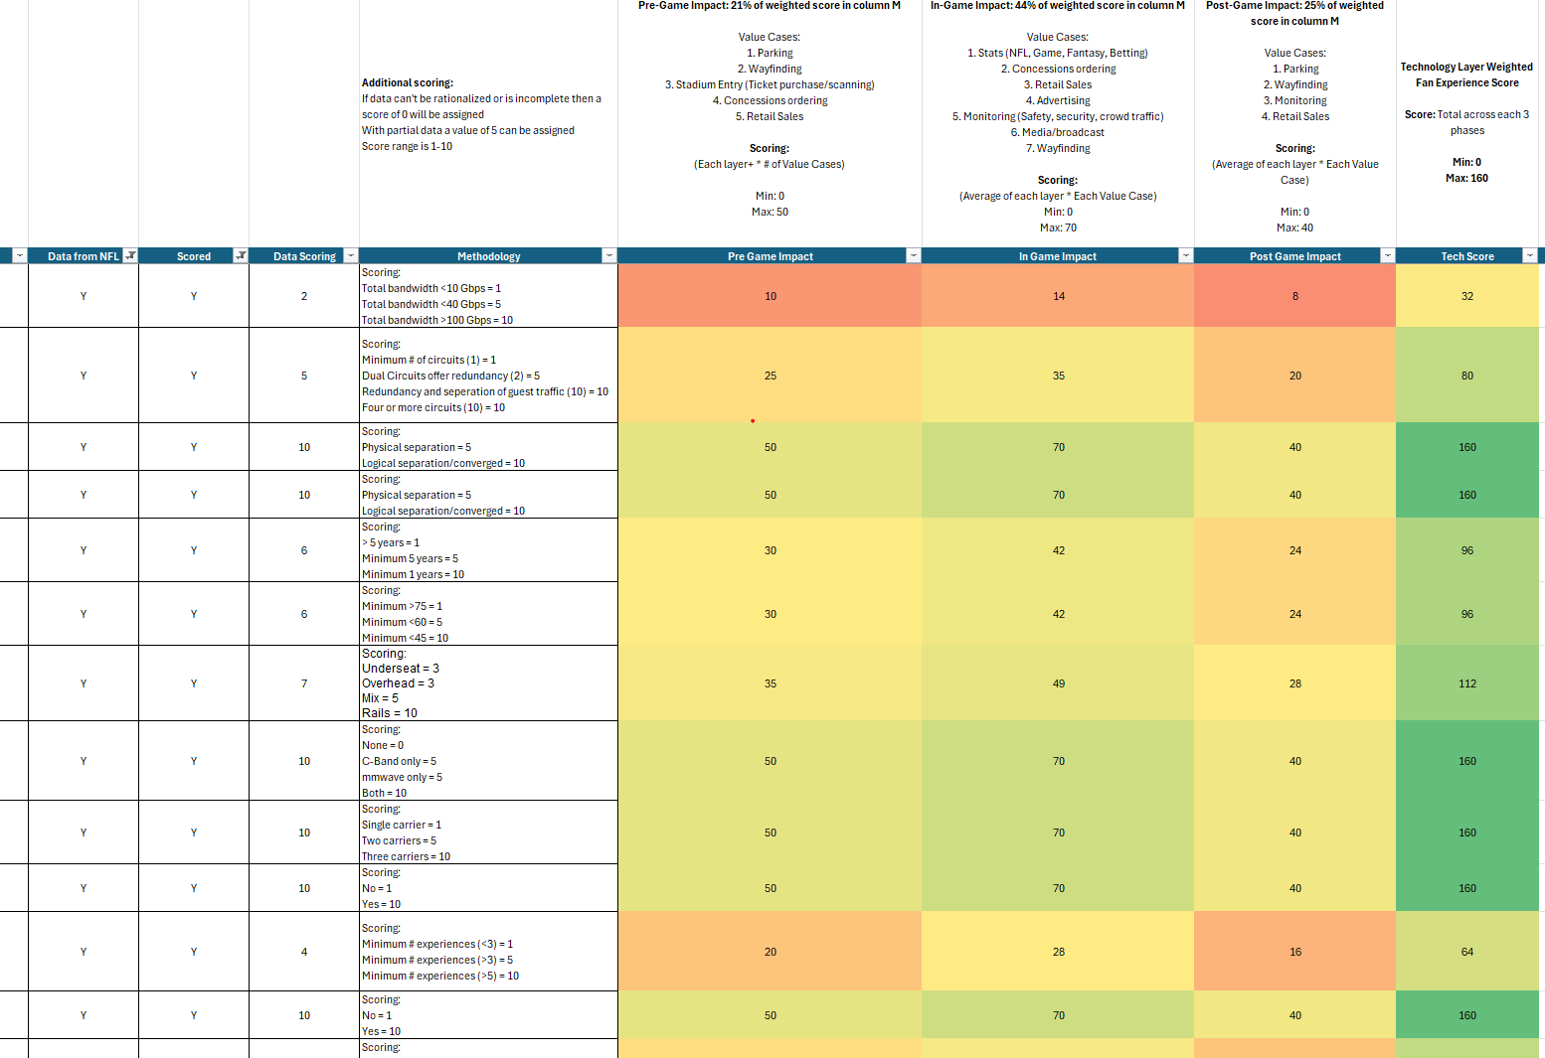
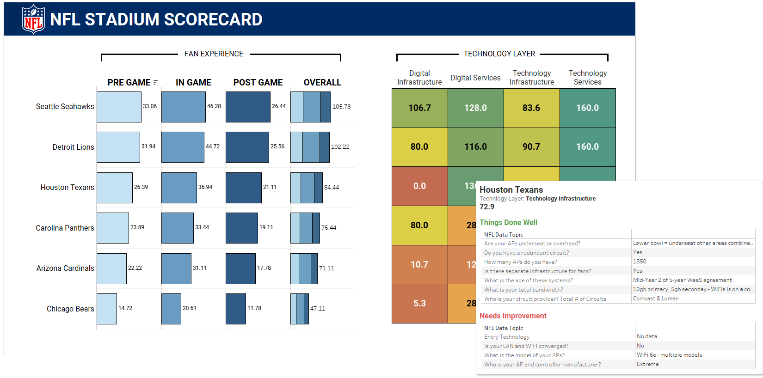
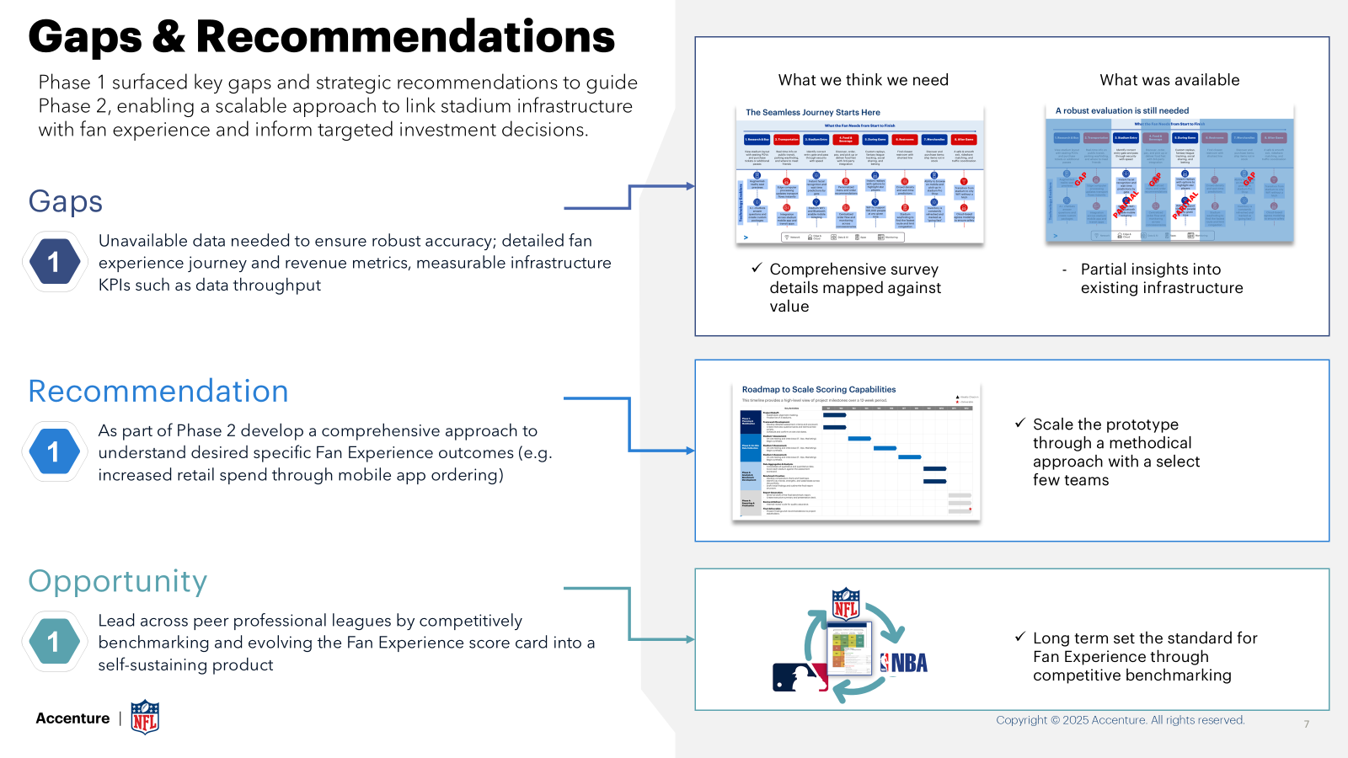
Phase 1 Methodology Overview
From Input to Impact: Scoring Simplified
Rationalized Data:
Responses were rationalized to data points where necessary (e.g. total bandwidth across all circuits, AP per user against stadium capacity) using industry knowledge + best practices
Technology Areas
Scoring Process
Input
Rationalized Data
Technology Infrastructure
Scoring XLS
Survey question by the NFL
Weighting Factors
Technology Services
Scoring (Scores From 0-10 Based On Methodology)
Digital Infrastructure
Tableau Dashboard
Data Visualization
Responses by NFL teams
Digital Services
Recommendations
AI & Innovation
For each topic scoring methodology includes:
If data can't be rationalized or is incomplete, then a score of 0 will be assigned
With partial data a value of 5 can be assigned
Score range is 1-10

Slide 9

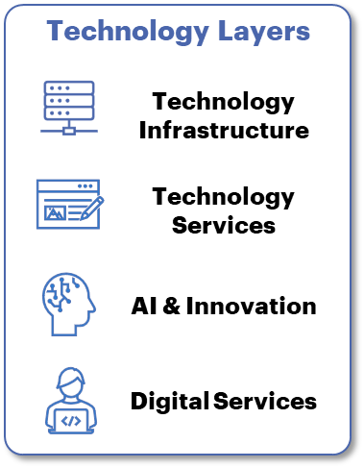
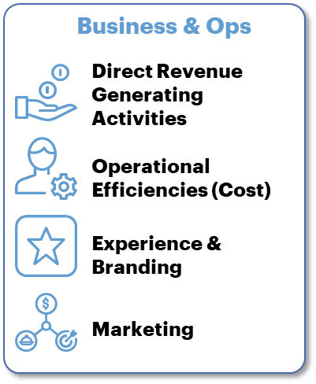
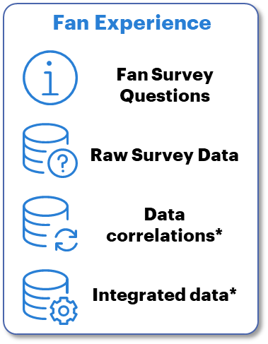
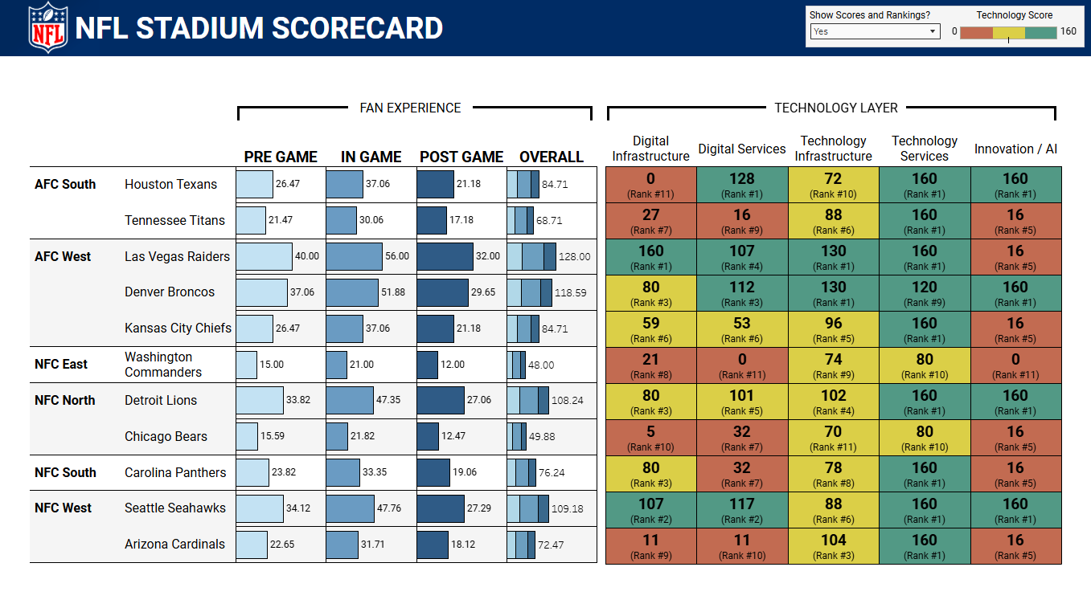
Phase 2 Methodology Overview
Connecting technology, operations, and fan value to guide investment priorities
*Approx ~40-60 questions
Tech Layer + Business + VOF Integration data
Technology Layers Ranked fan experience and operations enabling technologies
NEW
Survey Development
Finalize methodology
Review with 3 clubs and update
Business & Operations Revenue or operational KPIs that support correlations needed to assess technologies
Survey Ingestion
Develop backend ingestion engine
Develop frontend surveys
Back-end Business Logic
Build out methodology system logic
Test logic for production
NEW
Fan Experience Voice of the Fan survey questions and data that support *
Dashboard Outputs
Send out 32 team surveys
Automatic dashboard updates
*NEW: Business/Operations and VOF correlations:
Dashboard insights are more defensible with correlated data
Integrated results to help support investment decision making

Slide 10
Survey Development Business & Operations Survey Insights
By linking technology capabilities to measurable value outcomes, we ensure our scoring model reflects real business impact and guides smarter, value‑driven decisions across the NFL ecosystem.
Direct Revenue Generation
Operational Efficiency
Fan Experience
Marketing & Advertising
Impact on incremental game-day revenue (tickets, merch, concessions)
Criticality to enabling transactions
Portion of fans whose spending this influences
Ability to support or enhance sponsor monetization
Annual cost savings potential (opex, capex, etc)
Level of process automation or manual reduction
Avoided incidents / downtime
Improvements in resource utilization (staffing, energy, crowd flow)
Expected uplift to Voice of the Fan Experience survey
Depth of fan engagement enabled
Enhancement of sponsor brand delivery quality
Differentiation of in-stadium experience
Criticality to live broadcast quality/reliability
Enhancement of content capture and coverage
Ability to enable additional or higher-value ad inventory
Ease of integration for media / sponsor partners

Slide 11
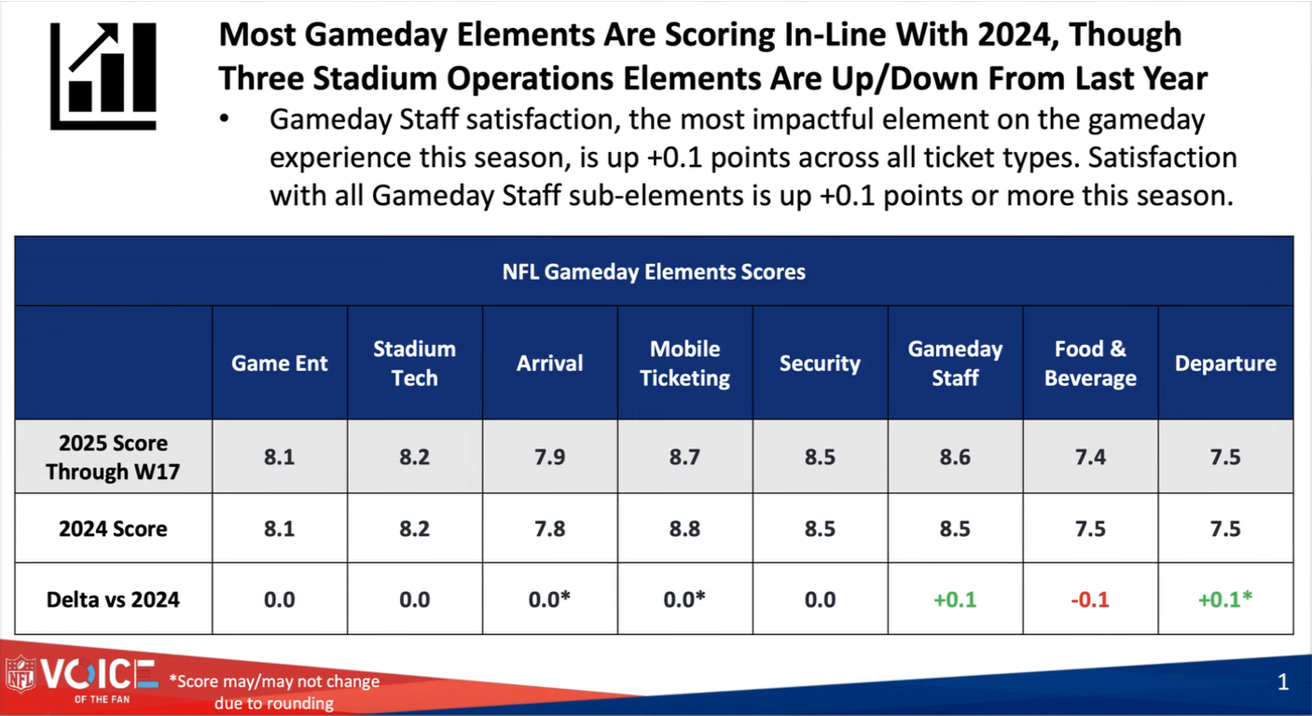
Voice of the Fan Data
Integrating the voice of the fan into value‑based technology prioritization
Key Information Needed
Full list of Voice of the Fan questions and scoring scales.
Definitions for each gameday value driver (mobile ticketing, gameday staff)
Access to underlying survey data or dashboards to understand trends and correlations
Methodology details: weighting factors, scoring logic, and segmentation approach
Year-over-year results to contextualize the 2020-2025 core changes
Drivers behind increases / decreases in specific elements (e.g. Food & Beverage)
Clarity on how fan-experience elements map to employee workflows or roles
Any operational KPIs used alongside fan sentiment to evaluate technologies
Integrating VOF and correlating into Scoring Dashboard

Slide 12
Illustrative update to Scoring Weights
We need to determine how best to rationalize and correlate using KPIs, revenue insights, VOF data here.
Strengthening investment decisions with data‑driven weighting
Prototype – Rough Order Value
Phase 2 - Defensible Data Driven
A
Pre-Game Impact
21%
A
Pre-Game Impact
21%
B
Value Cases
B Value Driver | Scoring (1–5) | Scoring description
Cost Savings Potential | 3 | Cuts manual counts; optimizes staffing and routing
Incident/Downtime Avoidance Value | 4 | Early congestion/safety detection prevents delays/overtime
Resource Utilization Improvement | 5 | Improves gate allocation, concessions staffing, cleaning cycles
Average | 4
Parking
Wayfinding
Stadium Entry (Ticketing)
Concession Ordering
Retail Sales
5x
C
Survey Result Score
1-5
C
Survey Result Score
1-5
D
Weighted Score
A*B*C
D
Weighted Score
A*B*C

Slide 13
Illustrative Survey Questions
Survey Question
Answer Options
What is the avg. infrastructure utilization of capacity?
<Please average the following: Wi-Fi, LAN, NH-DAS, Wired to Stadium>
Select One:
A) < 50%
B) 51 – 75%
C) > 75%
Correlation Opportunities
1
Impact to concessions
Impact to retail sales
Impact to gate entry/exit
Impact to service delivery to partners
Impact to mobile applications
Impact to 3rd party integrations
Impact to advertising capabilities
Impact to innovation rollouts
Impact to non-gameday operations
Impact to stadium maintenance operations
How many IT service calls happen leading on game day?
<Please be inclusive across infrastructure, services partners, etc>
Select One:
A) < 20
B) 20 – 50
C) >50
2
Multi-Select options:
N/A, Crowd Density, wayfinding, concessions demand, predictive maintenance, etc.
Where does predictive analytics provide the most revenue and/or operational savings?
<Please select from the list>
3
Multi-Select options:
AI chatbot, Concessions, Replays, Wayfinding, Spill reporting, etc.
What capabilities are enabled on the mobile that generate revenue, impact fan experience, or support operations?
<Please select from the list>
4

Slide 14
Next Steps
Agreed upon scope
Finalize SOW for NFL review
Plan for kick-off while SOW is being finalized/signed
Finalize 3 clubs

Slide 15

Phase 2: Moving from Manual, Subjective Scoring to Automated, Defensible Benchmarking
Manual rationalization introduced scoring bias, review overhead, and limited scalability
Survey Received
”Free-form” responses
Manually rationalized data
Scores calculated
Scores weighted vs.
indicative value
Results manually exported to dashboard
Prototype
Standardized inputs eliminate manual normalization, reduce bias, and enable automated scoring across all 32 teams
Survey Received
Standardized responses
Automatically weighted against value
Dashboard automatically updated
Phase 2

Slide 16
Phase 1 Methodology Scoring Overview
2
GAME PHASES
3
Low
Pre-Game | In-Game | Post-Game
Stadium entry, parking, etc | Concessions, wayfinding, etc | Exit management, retail, etc
Medium
High
1
TECH LAYER
Digital Infrastructure | Broadband networks, cloud hosting, etc
Digital Service | SaaS, mobile applications, etc
Technology Infrastructure | Wi-Fi, DAS, Fiber, etc
Technology Service | Broadcast, 5G services, etc
AI / Innovation | New technology, POCs, etc
Tech layer capability ratings
3
(1) Technology layers weighted against impact to the (2) three phases of an NFL game and given a low, medium, high (3) capability score across each phase

Slide 17
Phase 2 Roadmap
This indicative timeline provides a high-level view over a 6-week period.
 | Key Activities | W1 | W2 | W3 | W4 | W5 | W6
Framework Development | Project Kickoff: Stakeholder alignment meetings Finalize vision and guiding principles Scheduling workshops and reviews
 | Framework Development: Finalize detailed assessment criteria and scorecard. Ingest Voice of Fan survey Finalize & Test methodology and scoring logic Refinement based on validations
Framework Validations | Team validations (3 clubs) Workshops with 3 clubs to refine survey
Dashboard Development | Survey Tooling & Dashboard Development Finalize survey on updated framework Tableau visualization based on methodology
 | Data Transformation Develop survey system logic Develop data cleanse logic Source data preparation Dashboard creation
 | Testing & Refinements Solution testing Visualizations refinements based on feedback
Survey & Dashboard Finalization | Survey Release Send out surveys
 | Dashboard Release Dashbaord go-live post survey results
A
B
A

Slide 18
Technology Layers
Business & Ops
Fan Experience
Technology Infrastructure
Direct Revenue Generating Activities
Fan Survey Questions
Technology Services
Operational Efficiencies (Cost)
Raw Survey Data
AI & Innovation
Experience & Branding
Data correlations*
Digital Services
Marketing
Integrated data*
Phase 2 Methodology Overview
From Input to Impact: Defensible data driven survey approach
NEW: Business/Operations and VOF correlations:
Dashboard insights are more defensible with correlated data
Integrated results to help support investment decision making
Technology Layers Ranked fan experience and operations enabling technologies
Survey Development
Finalize methodology
Review with 3 clubs and update
Business & Operations Revenue or operational KPIs that support correlations needed to assess technologies
Survey Ingestion
Develop backend ingestion engine
Develop frontend surveys
Back-end Business Logic
Build out methodology system logic
Test logic for production
Fan Experience Voice of the Fan survey questions and data that support *
Dashboard Outputs
Send out 32 team surveys
Automatic dashboard updates

Slide 19
Phase 2 Details
From Input to Impact: Scoring Simplified
Survey Design
Dashboard Build
Go-Live
Ingest VOF survey data
Refine survey questions
Refine methodology
Validate survey and methodology with NFL teams
Develop Survey guides
Develop Dashboard guides
Develop How-To guide for Survey
Build Google Forms Surveys per team
Build back-end survey system logic
Build Dashboard
Develop Dashboard guides
Test survey ingestion and dashboard
Dashboard go-live
Survey go-live
Monitor survey results and dashboard
Club reach-outs if needed for corrections

Slide 20
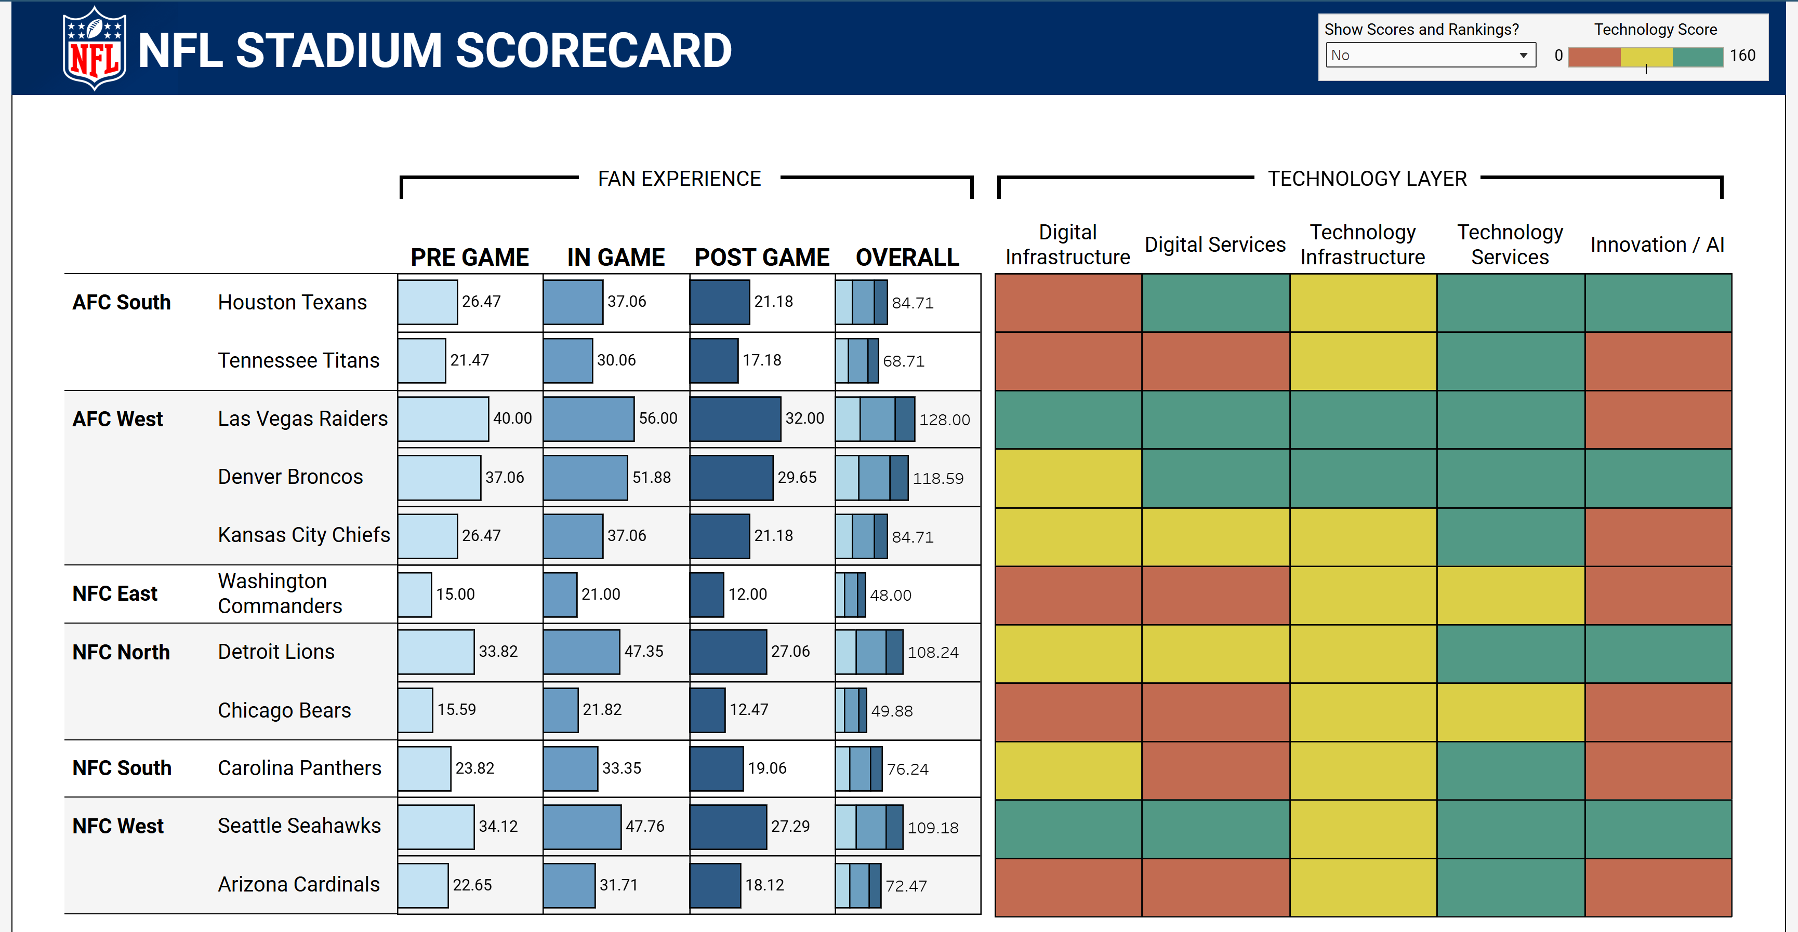

Phase 2 Scope Overview
Opportunity areas through benchmarking
Phase 2 builds on Phase 1 by refining strategic vision and business logic, integrating cross-team input for an NFL-wide view. Benchmarking global stadiums will uncover performance gaps and provide recommendations across technologies
1
2
NFL Focus Areas
Fan Survey Improvements
3
4
Operational Efficiency
Sustainability & Innovation
Prototype dashboard based on survey 1.0 data
Phase 2 Scope:
Update strategic vision and guiding principles for benchmarking
Develop four technology layer surveys (e.g. Infrastructure)
Integrate with voice of the fan
Benchmark against 3 international teams
Refine methodology and survey by iterating with 3 NFL teams
Build and launch a scoring dashboard and send out for all 32 teams
5
6
Connectivity & Infrastructure
Engagement & Personalization
7
8
Transaction & Commerce
Immersive Experiences
Copyright © 2025 Accenture. All rights reserved.
20

Slide 21
Technology Services
Cloud & Edge Platform Services
Remote and scaled management of devices and experiences plus edge compute
Broadcast / Media Enablers
Support for live content capture, reliability, advertising inventory, and sponsor integration (via value-driver scoring)
IT Support / Service Operations
IT service calls, incident avoidance, uptime protection, staffing optimization
Operational Efficiency Services
security, parking, ticketing, etc.
Vendor support
Maturity of infra for supporting vendor actives
Infrastructure
What is the avg. infrastructure utilization of capacity on game day? | Avg of Wi-Fi, LAN, NH-DAS, Wired to Stadium | Single Select
What % of APs are Wi-Fi 6 enabled? | | Single Select
Average data volume per game? | |
Network & Connectivity
Wired/wireless communications connecting platforms, devices, and users
Wi‑Fi 6/6E
Stadium‑wide coverage enabling mobile ordering, navigation, and high‑density fan engagement
LAN / Core Network & Utilization
Measurement of infrastructure utilization (Wi‑Fi, LAN, DAS, wired systems) and impact correlations (concessions, retail, ticketing, maintenance)
DAS / Cellular / 5G
Distributed Antenna System performance, modern bands, and mmWave coverage in bowl and concourses (referenced in survey questions and infrastructure layer)
Fiber & Backhaul
Bandwidth capacity, redundancy, and circuit diversity underpinning all
Edge Compute Infrastructure
Supports computer vision, latency‑sensitive apps, and operational automation
Physical Devices & Sensors
Cameras, sensors collecting interaction and source data for operational awareness

Slide 22
AI & Innovation | Adoption, use case, performance, type questions
Facial recognition and authentication
Crowd control, incident response
Edge Compute capacity/ use cases
Predictive analytics
Revenue and operational savings (concessions demand, crowd flow, predictive maintenance)
Digital Services | Adoption, use case, performance, type questions
Integrated point of sale
Mobile Application integration
How integrated with fan experience
B2B tools
Advertising sponsors, etc.
Ticketing
Customer Services

Slide 23
Business & Operations Survey Insights
We average the impact ratings in each bucket to create a unified score that reflects how strongly a capability supports that specific value area. Applying these scores across all buckets gives us a balanced assessment of the capability’s total business importance. This approach ensures we can objectively rank and prioritize technologies based on their true enterprise value.
Stadium-Wide Wi-Fi 6/6E
Direct Revenue Generation
4
Computer-Vision & Crowd Analytics (Cameras + Edge AI)
Operational Efficiency & Cost
4
Metric | Rating (1–5) | Rationale (short)
Incremental Revenue Potential | 4 | Drives mobile ordering, merch offers, seat upgrades at scale
Transaction Enablement Criticality | 4 | Not mandatory for POS, but vital for app-led purchases
Addressable Fan Reach | 5 | Impacts the vast majority of attendees with smartphones
Sponsor Monetization Uplift | 3 | Enables digital activations; incremental, not primary driver
Metric | Rating (1–5) | Rationale (short)
Cost Savings Potential | 4 | Cuts manual counts; optimizes staffing and routing
Automation/Substitution Level | 3 | Augments staff; partial automation of decisions
Incident/Downtime Avoidance Value | 4 | Early congestion/safety detection prevents delays/overtime
Resource Utilization Improvement | 5 | Improves gate allocation, concessions staffing, cleaning cycles

